Slide 1

Client Sales

Slide 2
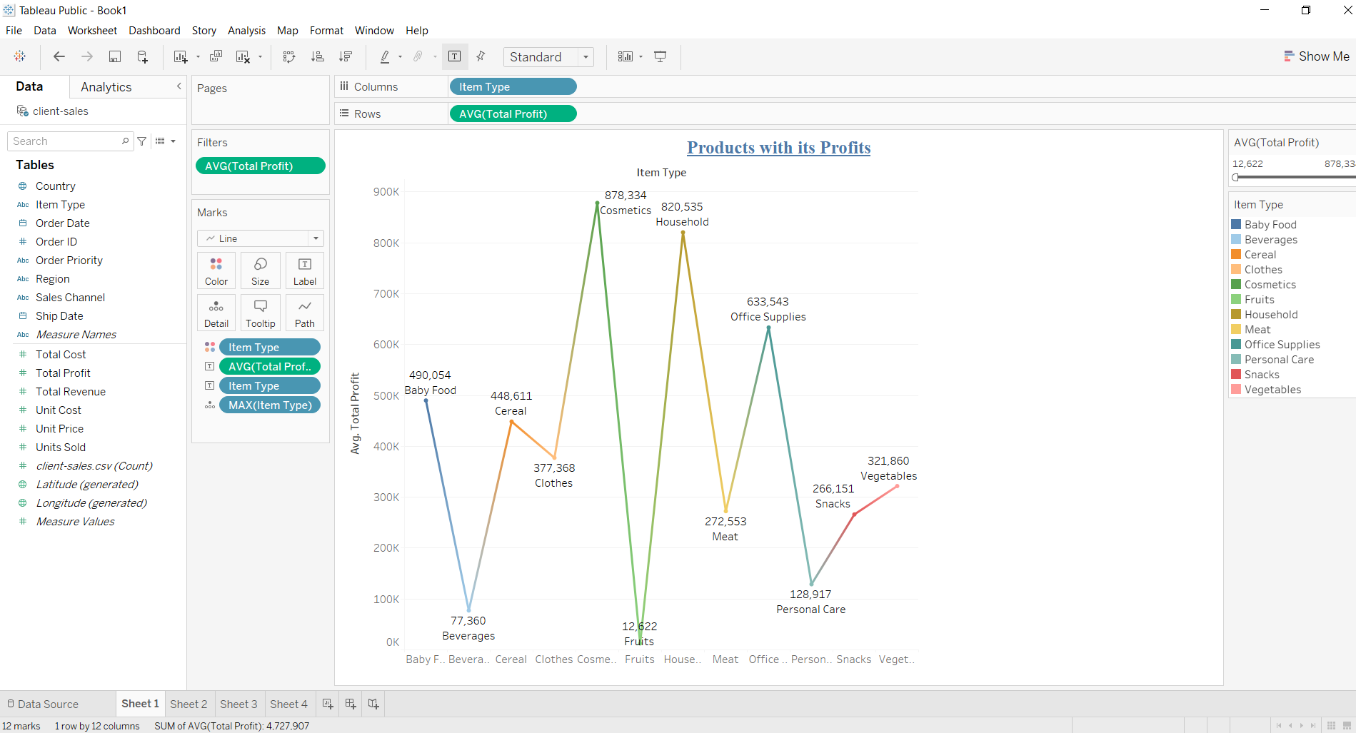
Products With Its Profits

Slide 3
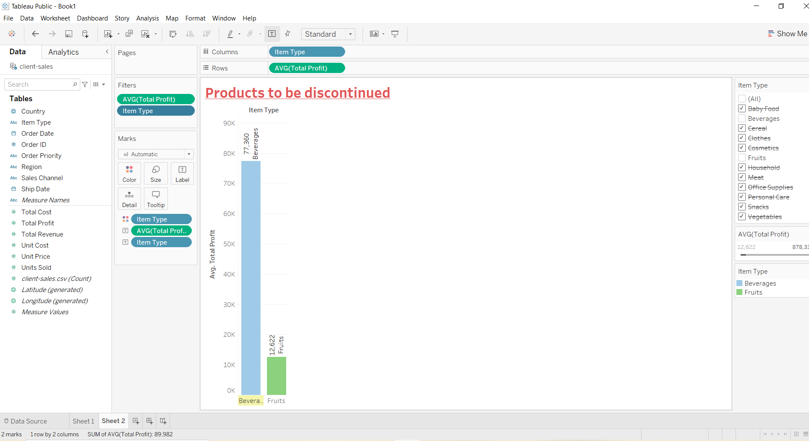
Products To Be Discontinued

Slide 4
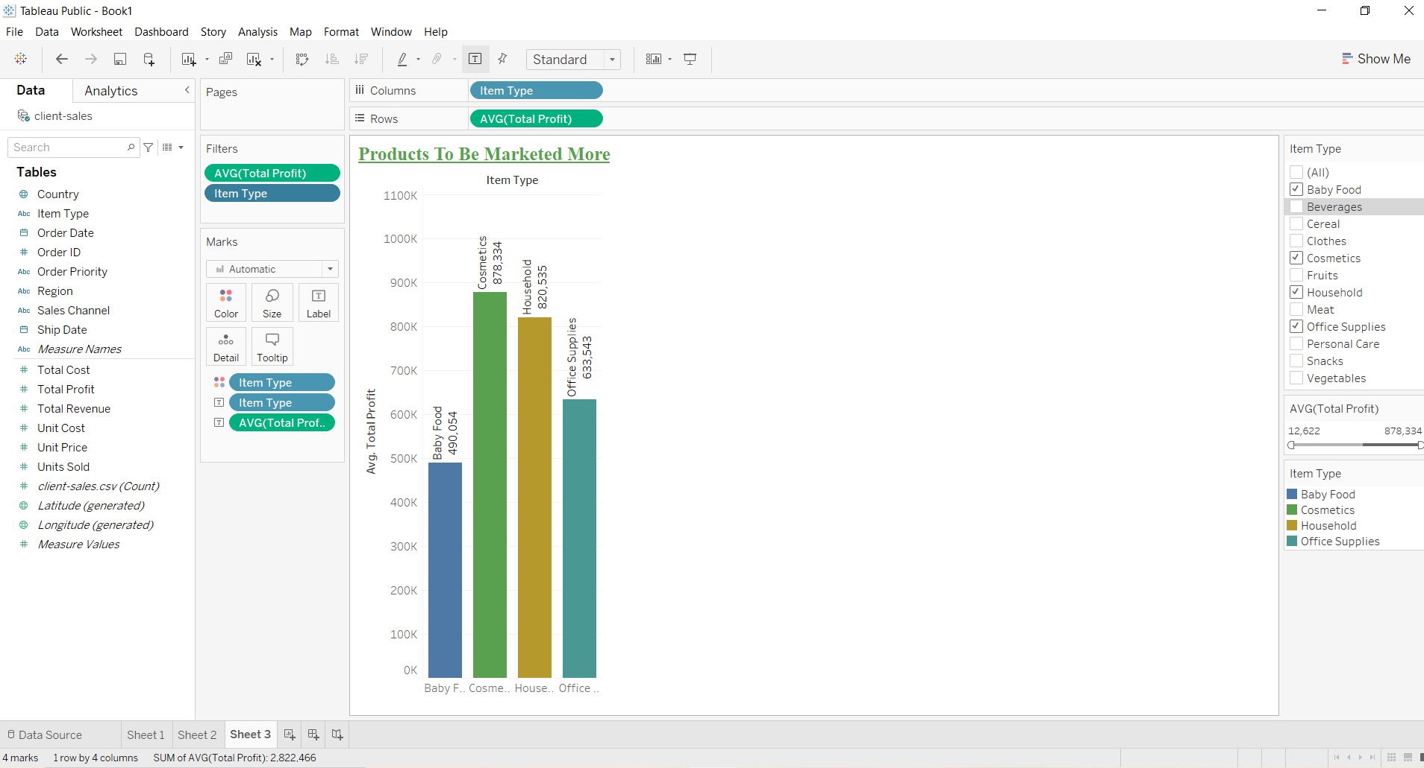
Products To Be Marketed More

Slide 5
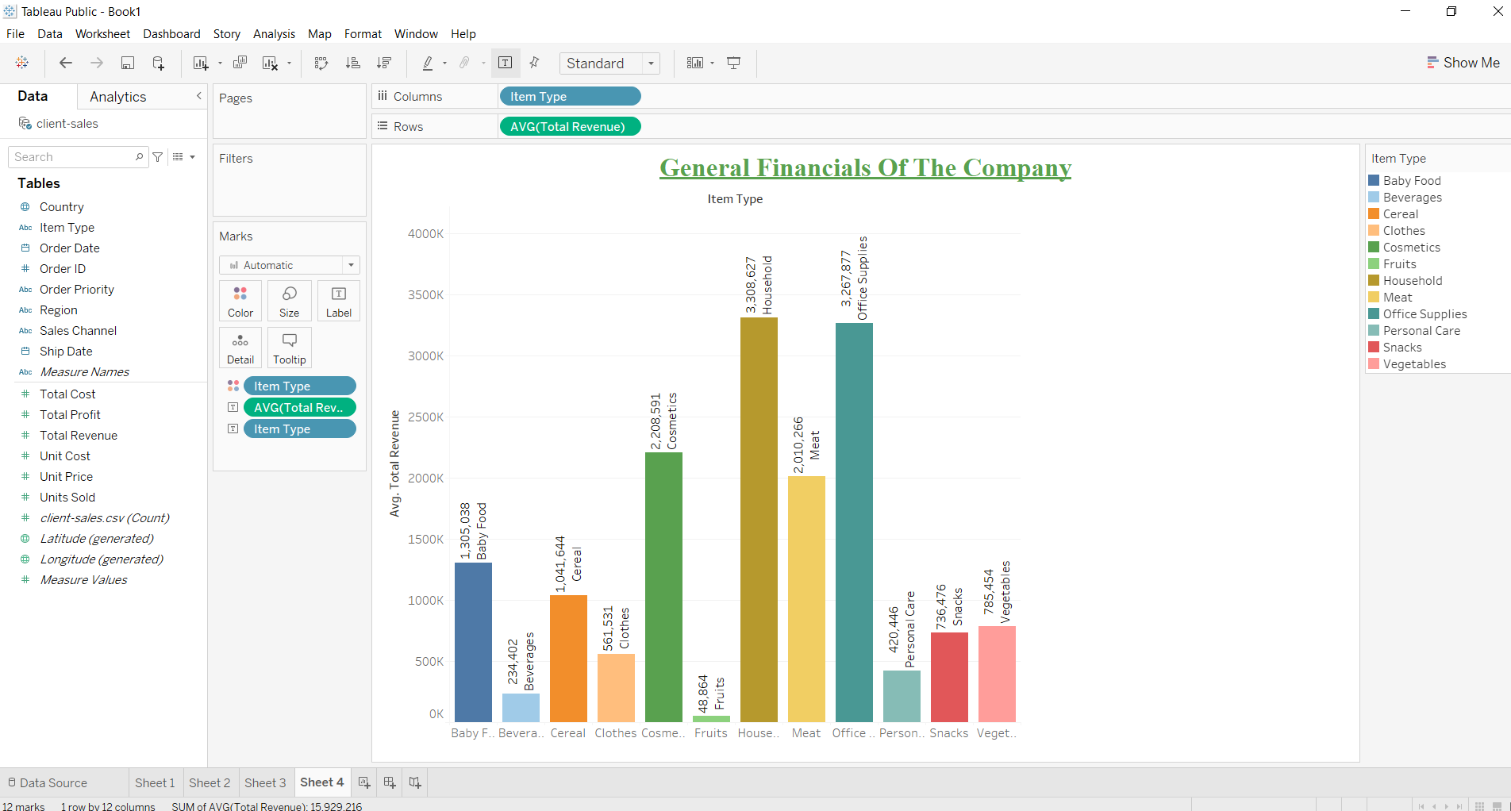
General Financials of the Company

Slide 6
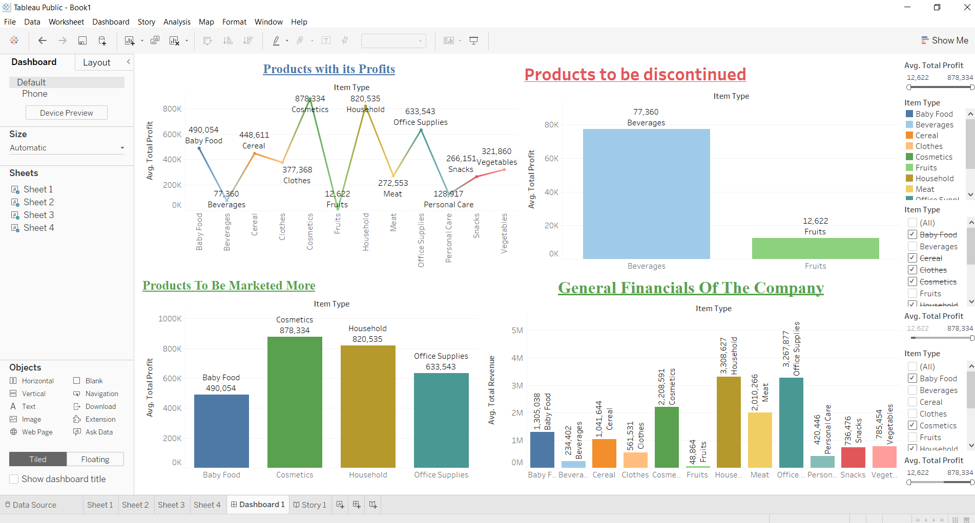
Dashboard:

Slide 7


